Slide 1

Aitor Hernández Sánchez Adrián Fleitas de la Rosa

Slide 2

Index
What is jQuery?
Why using it?
Installation and use
Syntax
Good practices
Examples
Ajax
Plugins
Conclusions

Slide 3
What is jQuery?

Slide 4
1. ¿What is jQuery?
JavaScript Cross-Browser library
Created by John Resig
DOM traversal
DOM manipulation
Event handling
Animation
AJAX

Slide 5
2. Why using it?

Slide 6
2. ¿Why using it?
jQuery is widely used
Open-Source
Promotes simplicity
Cross-Browser Compatibility
Clean syntax
Lightweight
SEO friendly
Utility features

Slide 7
3. Installation and use

Slide 8
3. Installation and use
<script> https://code.jquery.com/jquery-3.2.1.min.js </script>
$ npm i -D jquery
APP.use('/jquery', EXPRESS.static(PATH.join(__dirname, '../node_modules/jquery/dist/')));
import * as jQuery from './jquery/jquery.js';

Slide 9
4. Syntax

Slide 10
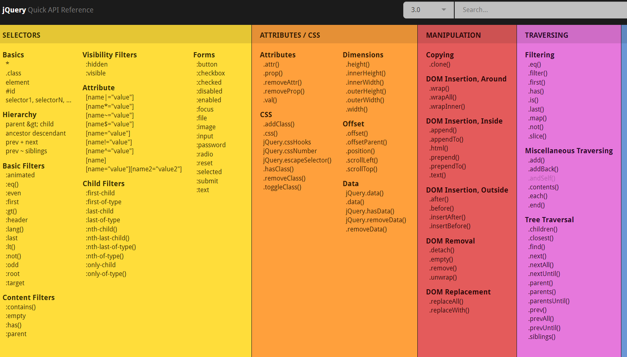
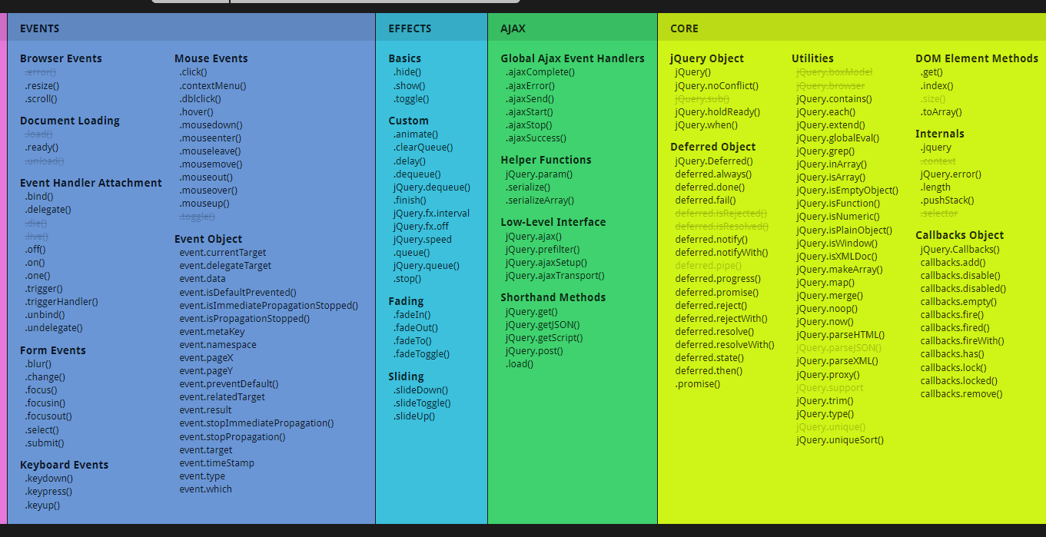
4- Syntax

Slide 11
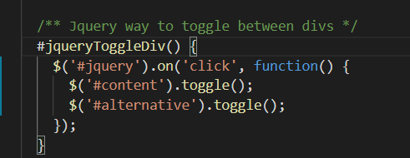
4- Syntax
Html tag -> $(‘p’)
By class -> $(‘.someclass’)
By id -> $(‘#someid’)

Slide 12
5. Good practices

Slide 13

5- Good practices
Naming with dollar sign $img = $(‘img’)
Avoid conflict using jQuery.noConflict()
Cache your jQuery object in a variable
Use chaining to reduce repetition
$('.test').addClass('hello').css('color', 'orange').prop('title', 'Hello world');

Slide 14
6. Examples

Slide 15
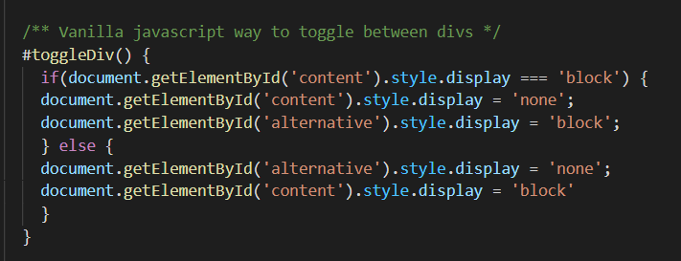
6- Examples
Toggle
http://10.6.130.141:8080/toggle.html

Slide 16
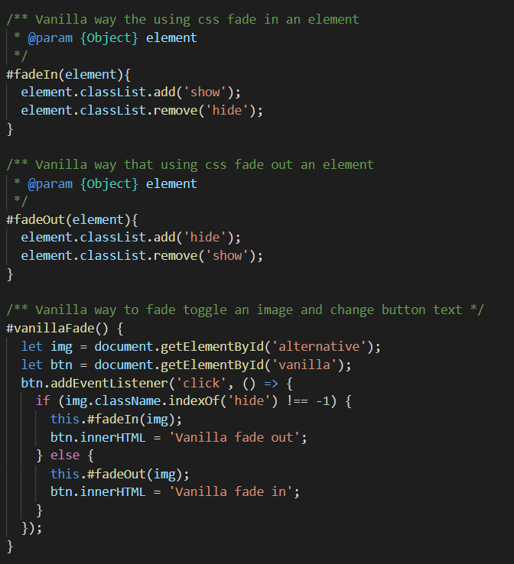
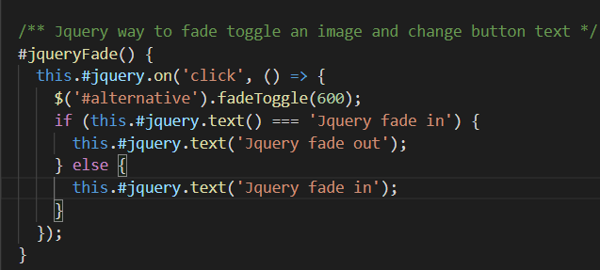
6- Examples
Fade
http://10.6.130.141:8080/fade.html

Slide 17
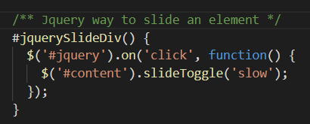
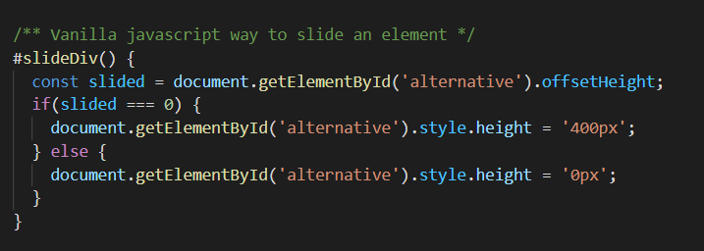
6- Examples
Slide
http://10.6.130.141:8080/slide.html

Slide 18
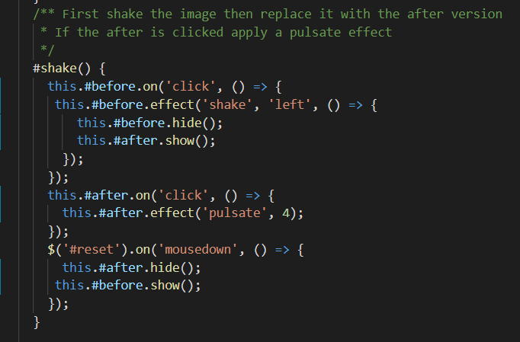
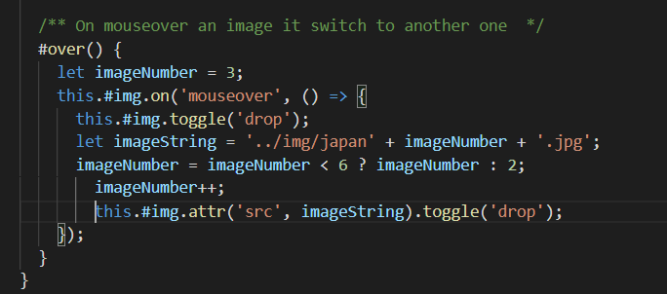
6- Examples
Shake and mouse over image switch
http://10.6.130.141:8080/index.html

Slide 19
7. Ajax

Slide 20
7. Ajax
Asynchronous JavaScript And XML
Gmail, Google Maps, Youtube, Facebook tabs...

Slide 21
7. Ajax
let response;
$.get(‘foo.txt’, function(data) {
response = data;
}
console.log(response);

Slide 22
7. Ajax
$.get( "foo.php", function( response ) {
console.log( response );
});

Slide 23
8. Plugins

Slide 24
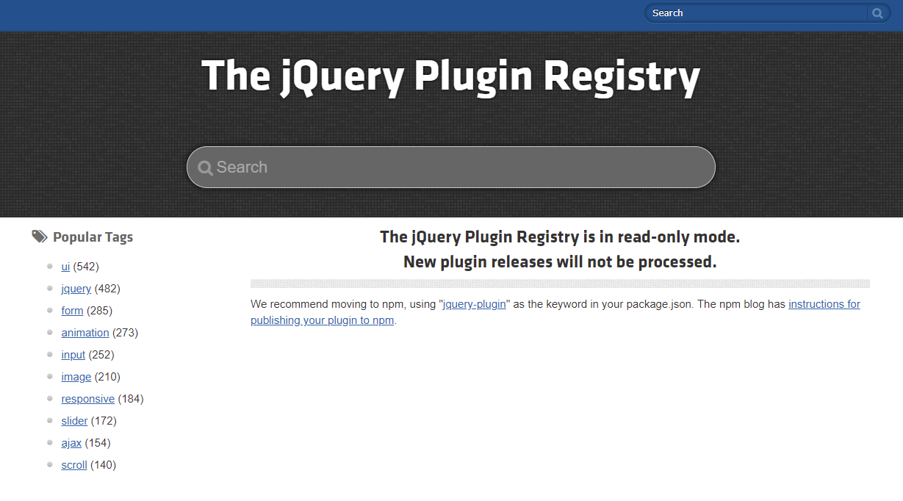
8. Plugins
plugins.jquery.com

Slide 25
9. Conclusions

Slide 26
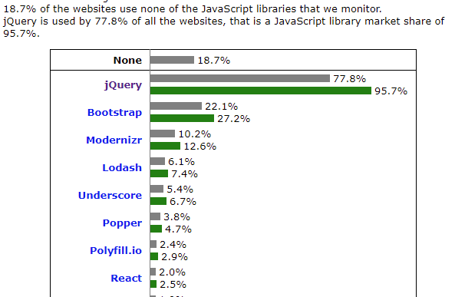
9. Conclusions
w3techs usage of jQuery

Slide 27
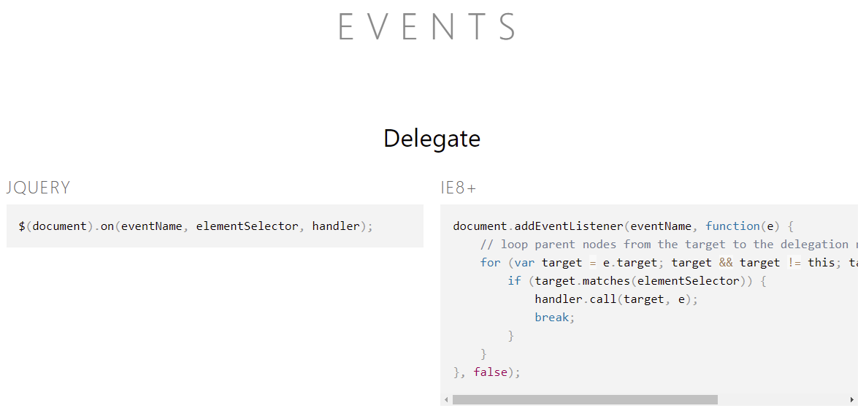
9. Conclusions
you might not need jquery

Slide 28


Equipo
Aitor Hernández Sánchez
Adrián Fleitas
de la Rosa
alu0100987522@ull.edu.es
alu0101024363@ull.edu.es

Slide 29

Bibliography:
https://stackoverflow.com/tags/jquery/info SO Post info and best practices jQuery
https://oscarotero.com/jquery/ Cheat Sheet
http://youmightnotneedjquery.com/ Vanilla Javascript vs jquery methods
https://learn.jquery.com/ Learn jQuery
https://tekslate.com/11-benefits-jquery-every-web-designers-know Benefits of jquery
https://w3techs.com/technologies/overview/javascript_library Usage of jQuery chart
https://plugins.jquery.com/ jQuery plugins registry

